Slide 1
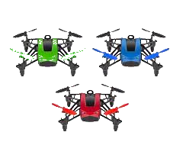
DEMO
FAU CS & CE EGN 4950C
DATE
Group 32: Tutku Gizem Guder
Brenden Martins Matthew Paternoster Matthew Wyatt Tarek Kayali
Multiple Drones Coordination

Slide 2
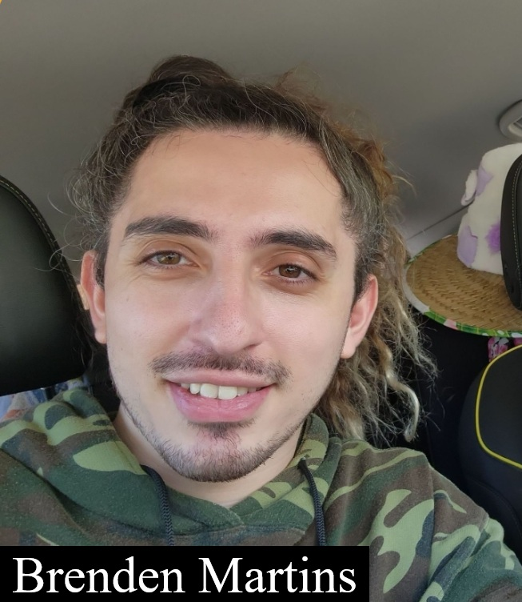

Introduction - Multiple Drone Coordination System
Multiple Drones Coordination
FAU CS & CE EGN 4950C
Group 32
Project Objectives
Our objective is to develop a system for coordinating multiple drones in a realistic 3D simulation environment, which is in response to the growing challenges current emergency response systems face in disaster ridden areas.
Challenges
These challenges include, but are not limited to, human safety risks, limited drone coordination systems, and inefficient testing environments for the drones. We plan to address these challenges by providing a scalable and efficient MDCS, which can increase the positive outcomes for areas that are facing disaster scenarios.

Slide 3
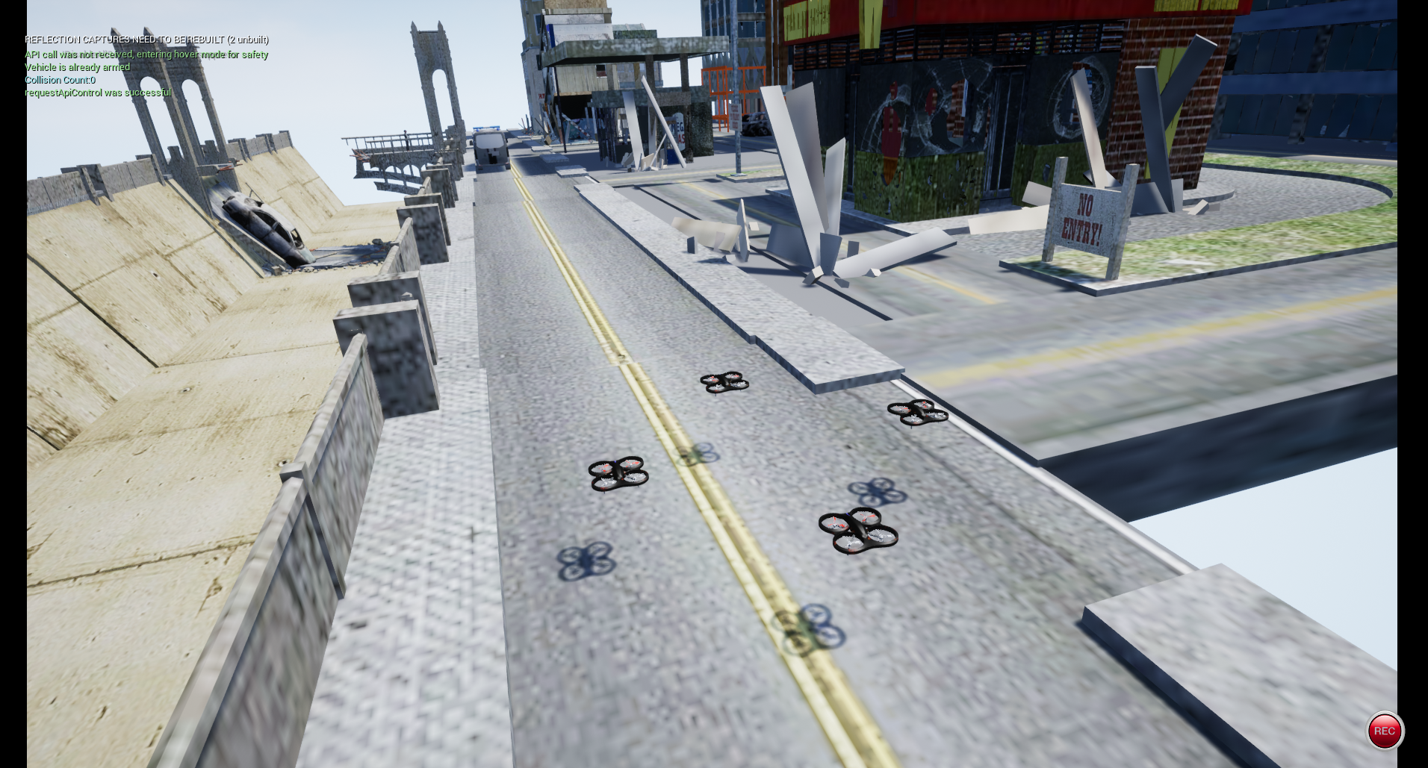
Proposed Solution
Multiple Drones Coordination
FAU CS & CE EGN 4950C
Group 32
Our Project aims to solve some of these challenges by developing a system for coordinating multiple drones in realistic simulated environment to carry out tasks like target detection and rescue operations.

Slide 4
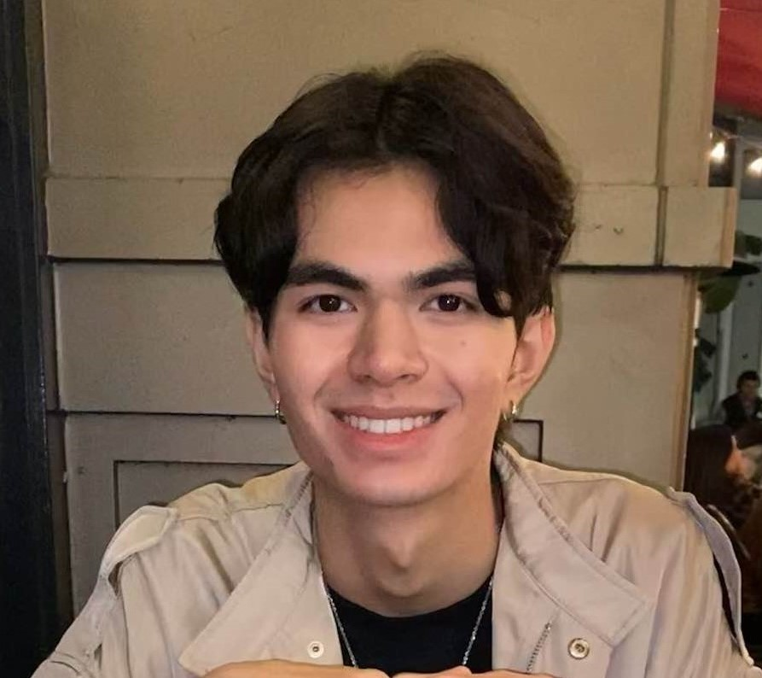
Tasks Accomplished - User Interface
Multiple Drones Coordination
FAU CS & CE EGN 4950C
Matthew Paternoster
Python Server Integration
Developed a Flask-based server using AirSim's API to connect to a simulated drone.
Successfully retrieved drone state data (position, altitude, speed, collision info).
User Interface Development
Built a React application that displays drone feeds, statuses, and logs.
Implemented a tabbed interface for switching between the drone feed, logs, and detailed status.
Integrated features like drone selection, periodic data fetching, and visual indicators (battery, status icons).
Error Handling & Connectivity
Added error messages and fallback images when the server isn’t connected or the feed fails.

Slide 5
Remaining Challenges
Multiple Drones Coordination
FAU CS & CE EGN 4950C
Matthew Paternoster
Drone Feed Display Issues
The live drone video feed is not displaying as expected in the UI.
Possible issues include image encoding, base64 conversion, or caching problems.
Debugging & Synchronization
Need to further debug the connection between the Python server and AirSim to ensure consistent image retrieval.

Slide 6

Multiple Drones Coordination
FAU CS & CE EGN 4950C
Matthew Paternoster

Slide 7
Brenden Martins (Simulation Management Subsystem)
Multiple Drones Coordination
FAU CS & CE EGN 4950C
Brenden Martins
Responsibilities
Built and configured the 3D simulation environment using Unreal Engine 4.27.
Integrated custom assets (terrain, buildings, vehicles, people) using Blender, FBX files, and FAB Marketplace.
Configured and optimized AirSim to support multi-drone simulation within the environment.
Mapped collision boundaries for complex models to ensure accurate drone interaction and navigation.
Incorporated dynamic environmental elements like weather and obscurations to simulate real world disaster conditions.
Coordinated closely with other subsystem leads to prepare the environment for camera feeds, target detection, and UI integration.

Slide 8
Progress & Remaining Challenges
Multiple Drones Coordination
FAU CS & CE EGN 4950C
Brenden Martins
Tasks Accomplished so far:
Created a functional 3D simulation environment using Unreal Engine 4.27.
Integrated realistic terrain and imported disaster-themed assets (vehicles, buildings, people).
Set up AirSim and configured it to support multi-drone scenarios.
Implemented basic drone control and custom drone spawn logic through Python scripting.
Mapped accurate collision for the simulation environment to improve realism and navigability.
Challenges:
Finalize seamless integration between drones and other subsystems like UI and target detection.
Stabilize the drone spawn and behavior to prevent erratic physics or camera issues.
Improve synchronization of multi-drone operations for coordinated mission Execution.
Ensure consistent performance during video recording and live demos.

Slide 9
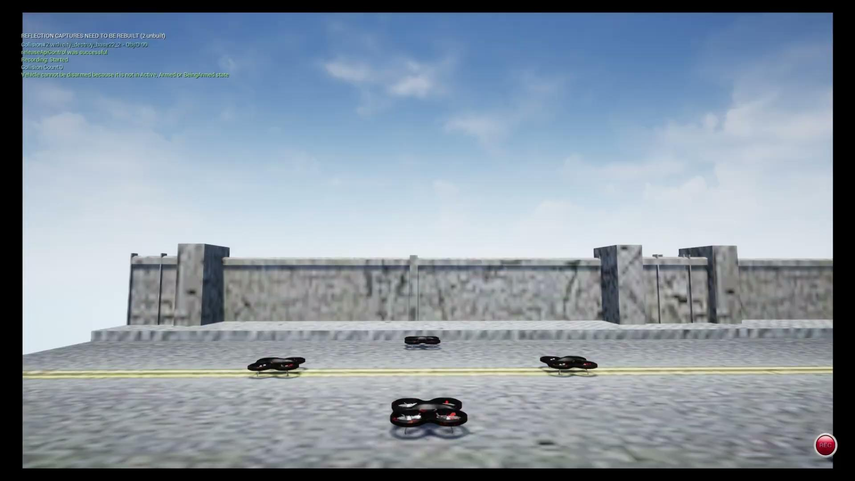
Demo Video
Multiple Drones Coordination
FAU CS & CE EGN 4950C
Tutku Gizem Guder

Slide 10
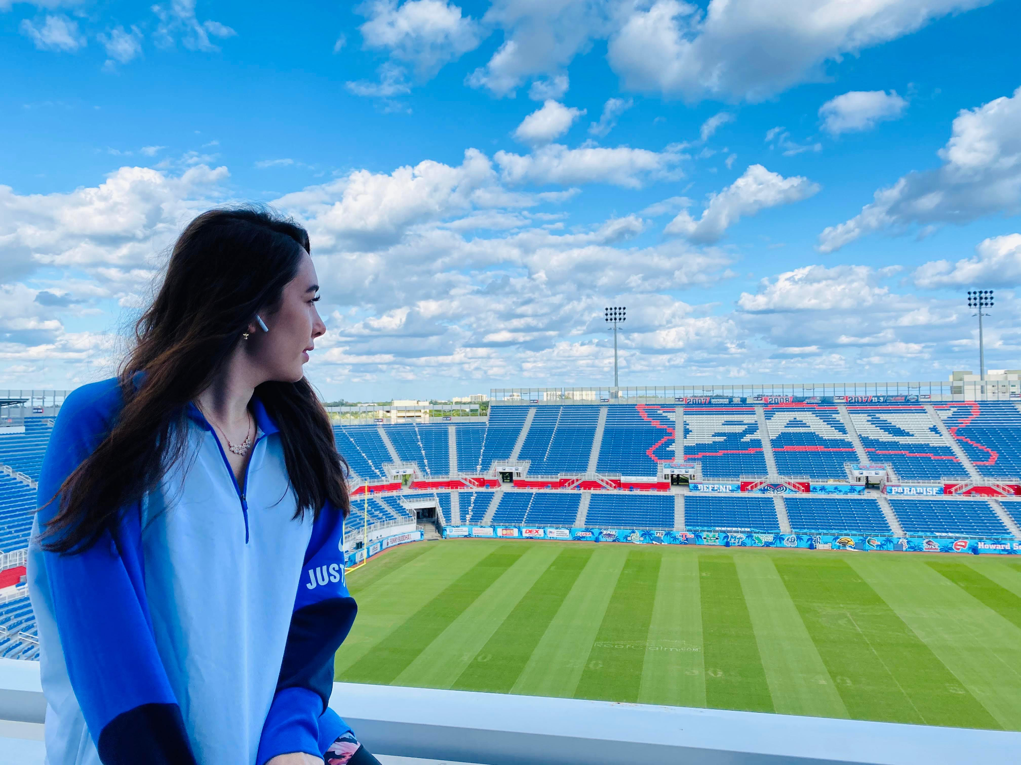
Individual Plan
Target Detection Subsystem
FAU CS & CE EGN 4950C
Tutku Gizem Guder
Tutku Gizem Guder- Target Detection Subsystem
Responsibilities / Objective
Developing and implementing a target tracking and detection algorithm for real-time identification and monitoring.
Managing sensor integration and machine learning model training for accurate target identification.
Handling challenges in real-world testing variability and processing load optimization.
Developing a simulation environment for model testing and integration.
Integrating target detection data with Drone Control and Data Management subsystems.

Slide 11
Progress and Remaining Challenges
Target Detection Subsystem
FAU CS & CE EGN 4950C
Tutku Gizem Guder
Tutku Gizem Guder- Target Detection Subsystem
Done
Successfully developed and tested a target tracking and detection algorithm for real-time identification through Unity
Integrated multiple sensor data streams and machine learning models for improved target identification accuracy.
Conducted initial testing in the simulation environment to assess algorithm performance and accuracy under varied conditions.
Challenges
Encountered integration challenges due to Unity and Unreal Engine mismatch; currently unable to integrate the algorithm with the drone.

Slide 12
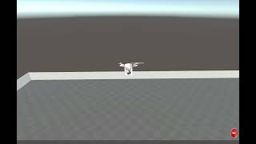
Demo Video
Target Detection Subsystem
FAU CS & CE EGN 4950C
Tutku Gizem Guder

Slide 13
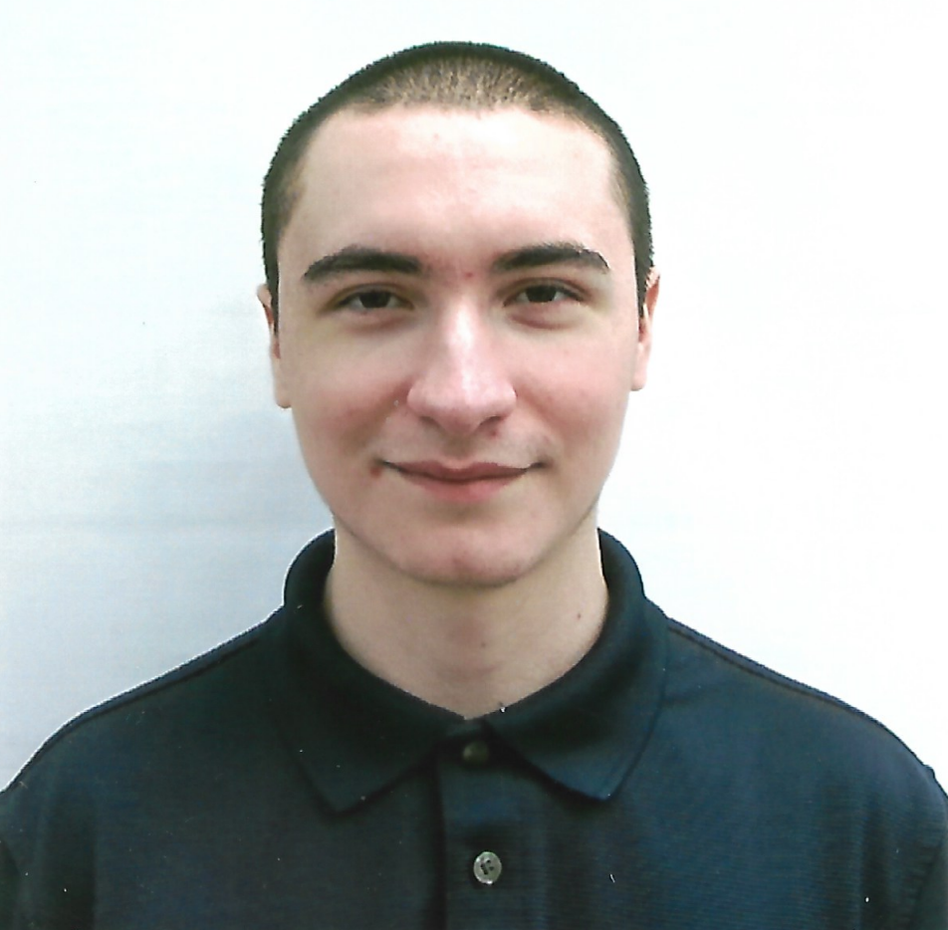
Individual Plan
Multiple Drones Coordination
FAU CS & CE EGN 4950C
Matthew Wyatt
Matthew Wyatt - Data Management and Communications Subsystems
Responsibilities / Objective
Facilitate reliable data exchange between drones and control systems.
Ensure stable connectivity and low-latency communication across all drones.
Store and manage large volumes of operational data securely.
Provide scalable data storage capabilities for real-time access and archival.
Major Milestones
Created MySQL server and migrated to from lamp.cse.fau.edu to Freesqldatabase.com for external access.
Created API using ExpressJS to communicate with other subsystems.
Helped set up communication between the drone control, UI, and simulation environment using Python scripts.
Tested and validated data synchronization between the MySQL database and AirSim simulation.

Slide 14
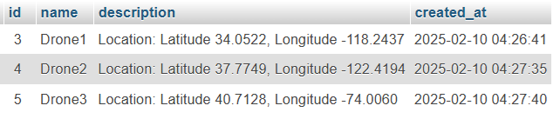
Progression
Multiple Drones Coordination
FAU CS & CE EGN 4950C
Matthew Wyatt
Matthew Wyatt - Data Management and Communications Subsystems
Done
Reviewed the MySQL database schema, data integrity, and relevance.
Continued evaluation and optimization of the MySQL database for better performance.
Migrated the MySQL server from lamp.cse.fau.edu to Freesqldatabase.com for external access.
Helped deploy Python scripts to enable communication between the drone control, UI, and simulation environment.
Ensured that the data between the MySQL database and AirSim remains synchronized.
To Do
Maintain data consistency between the database and the simulation environment.
Conduct stress testing for the Python-based communication scripts to ensure reliability under load.
Finalize integration testing between all subsystems to confirm seamless operation.

